Slide 1
Phi Beta Sigma Fraternity, Inc.
Sigma Sigma Sigma Chapter
Sigma Beta Club All Hands Meeting
February 13, 2022

Slide 2
Agenda
Welcome / Meeting Purpose
SBC Coordinator Biography
SBC Story
Chapter Story
SBC Advising Committee
Club Highlights
2021-2022 Goals
2021-2022 Events
2021-2022 Success
2023-2024 Way Forward
COVID-19 Regulations
Closing Remarks

Slide 3
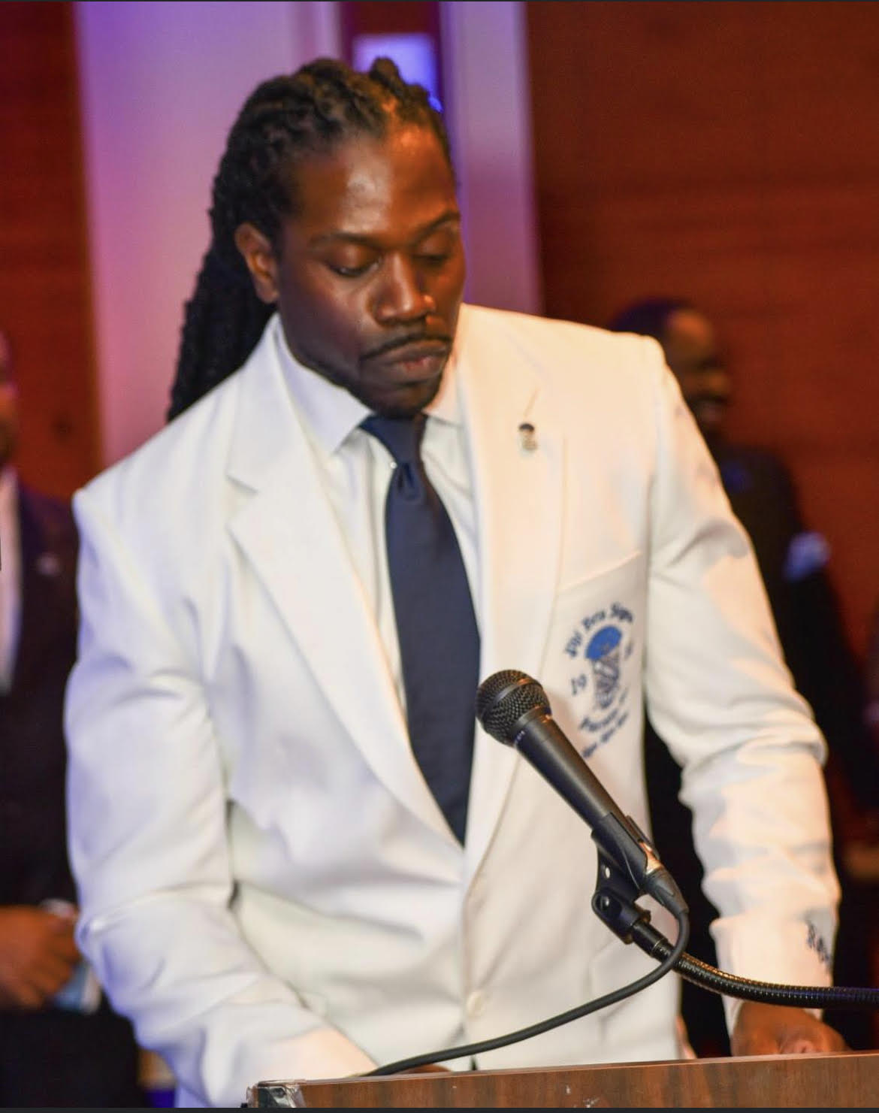
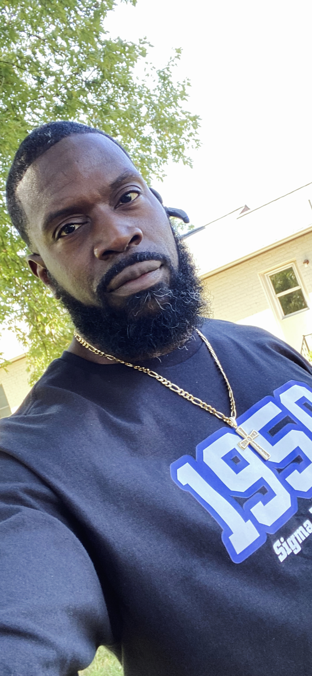
Coordinator’s Biography
Biography
Brother Roston Fyle
Born in NYC, raised in Northern, NJ
Sierra Leonean / Black American
Attended Utica College of Syracuse University
Student / Athlete – Men’s Basketball
Initiated into Phi Beta Sigma Fraternity - Spring 99 - Omicron Alpha Chapter - Utica, NY
Graduated with a BS in Cyber Security
Attended George Washington University in 2009
Joined TriSigma Chapter in 2009
A founder of the Gamma Alpha Phi Chapter, chartered in 2012 @ George Washington
Graduated with an MBA from GW in 2012
Served as a past BBB Director & Sergeant-in-Arms of Sigma Sigma Sigma Chapter
Sigma Beta Club Advisor from 2015-Present
Sigma Beta Club Coordinator 2021-Present

Slide 4
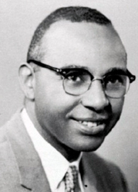
Sigma Beta Club Story
Our Story
Founded on April 23, 1954 by Dr. Parlett Moore
Youth Auxiliary Club of PBS (ages 8 -18)
National SBC Programs
Education
Social Action
Bigger & Better Business
Childhood Obesity & Health and Wellness
National Sigma Beta Club Foundation (NSBCF)
Incorporated on June 1, 2005
Command & Control of the Clubs
Motto: “The Next Generation of Leaders Accepting the Responsibility and Loving the Challenge”

Slide 5
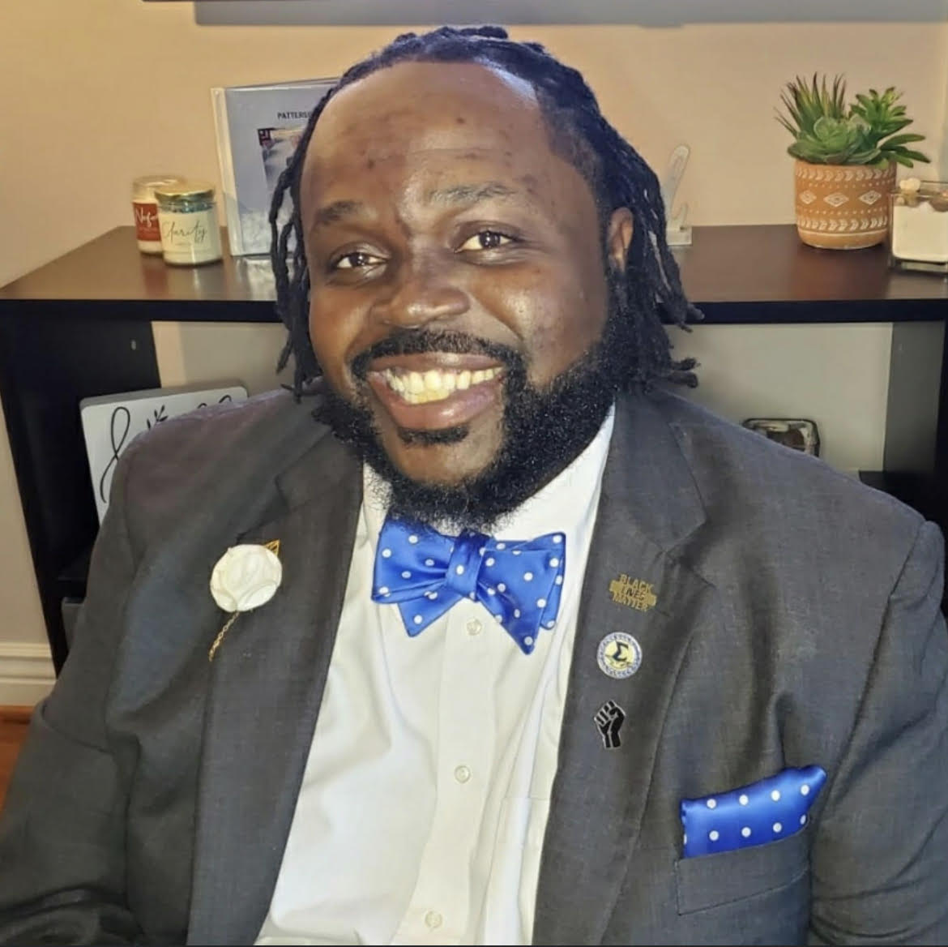
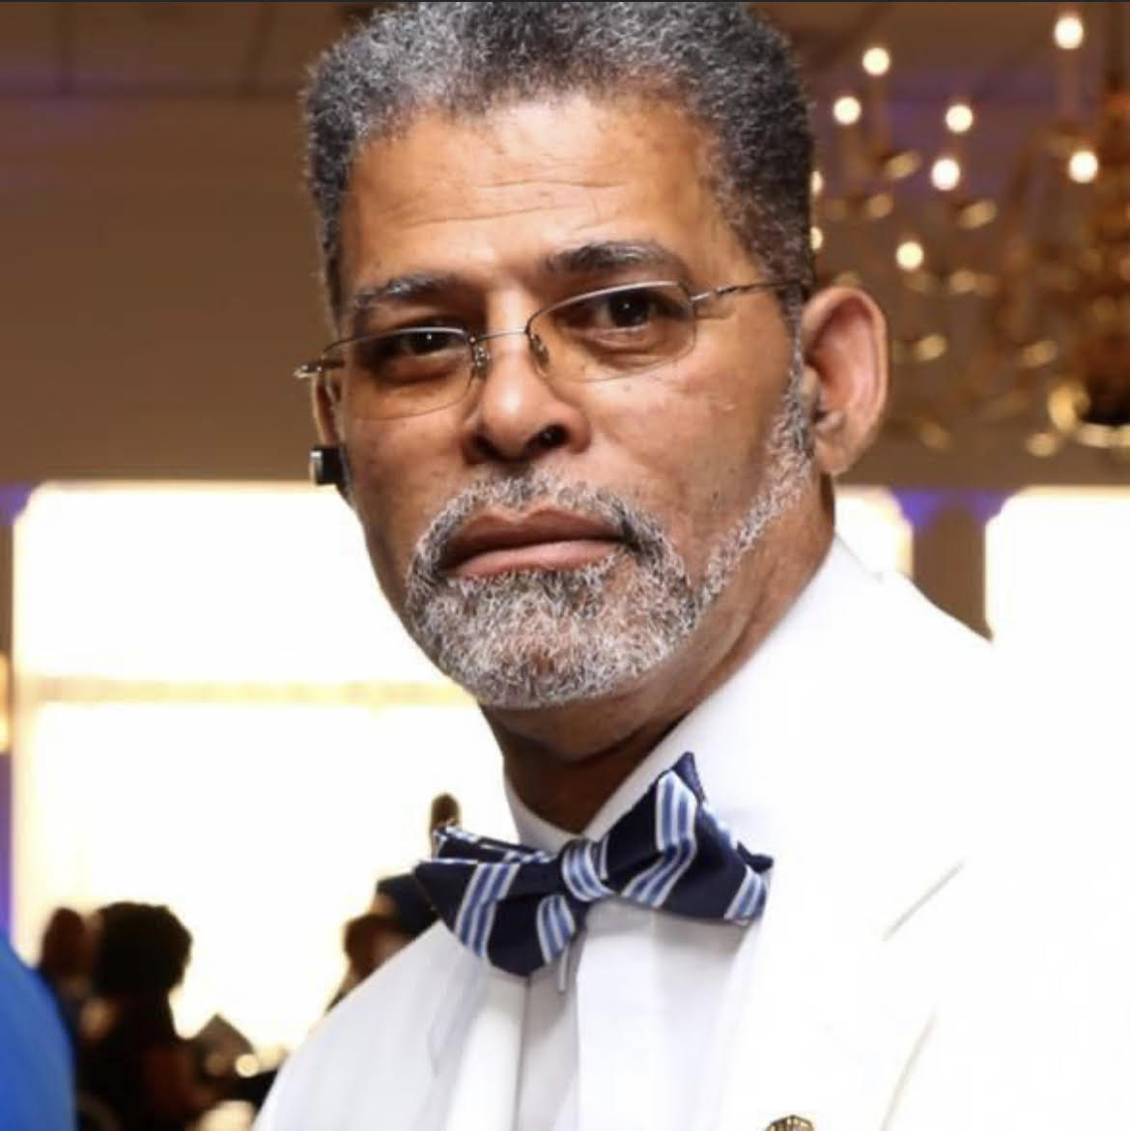
Chapter SBC Story
Founded on March 30, 2013
Founder: Bro. Randy Patterson Jr.
Vision: Bro. Steven Taylor Sr. (SSS Chapter Founder and Past President)
Chartering Sigma Betas
Robert Brown III, Jaden & Tyler Chambers, Jordan & Nile Charles-Horne, Maxwell Coward, Garben Ladden IV, Jordan & Joshua McConnie, Christian & Courtney Jr. Souvenir, Garvin St. Villler, Tre Treutelaar
Past Coordinators
Bro Randy Patterson Jr. (’13 –’16)
Bro Robert Brown (‘17 – ’20)
Sigma Sigma Sigma Chapter and our Advisors are dedicated to the growth and Development of Young Men in our Community

Slide 6
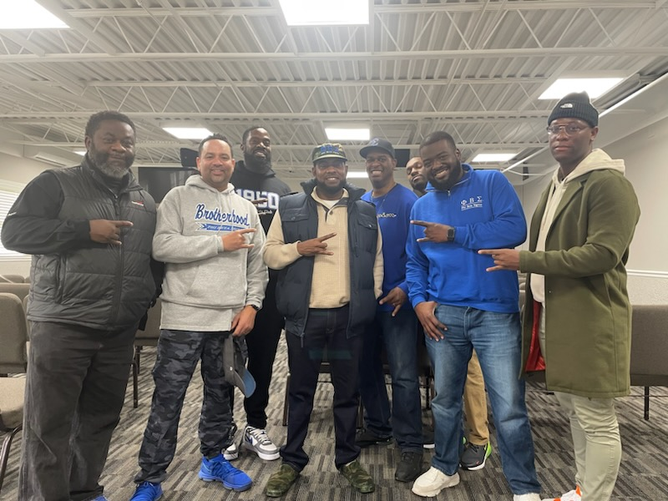
SBC Advising Committee
Bro Robert Brown
Bro Carl Coward
Bro Roston Fyle
Bro Tony Johnson
Bro Randy Patterson Jr.
Bro Derrick Simmons
Bro Seun Sonuyi
Bro Courtney Souvenir Sr.
Bro Byron Turner

Slide 7
Club Highlights
SBC Highlights Since 2013
100% College Acceptance rate of our Sigma Betas after graduating High School
Each Beta has received a PBS Scholarship upon graduation
Multiple Betas are currently attending colleges and universities near and far
Many Betas have graduated from college, some as Sigma Men. Some Betas have returned to the club to offer words of wisdom to our current Sigma Betas
Performed multiple Initiation Ceremonies; Initiated 17 Betas in August 2021 Virtually
Performed countless Community Service hours through vast initiatives such as MLK Day, Relay for Life and Adopt-a-Highway
Facilitated close to 100 educational sessions, many with activities and guest speakers to aid in the development of our Sigma Betas
Eastern Regional Director of Sigma Beta Clubs is an advisor
Two Chapter Brothers sit on the NSBCF Board of Advisors

Slide 8
2021-2022 Goals
SBC Goals
Establish and maintain a heightened programming standard during while adhering to the NSBCF’s COVID-19 moratorium
Keeping our Sigma Betas engaged with the club and activities while meeting virtually
Positively impact the lives of our Sigma Betas during the pandemic

Slide 9
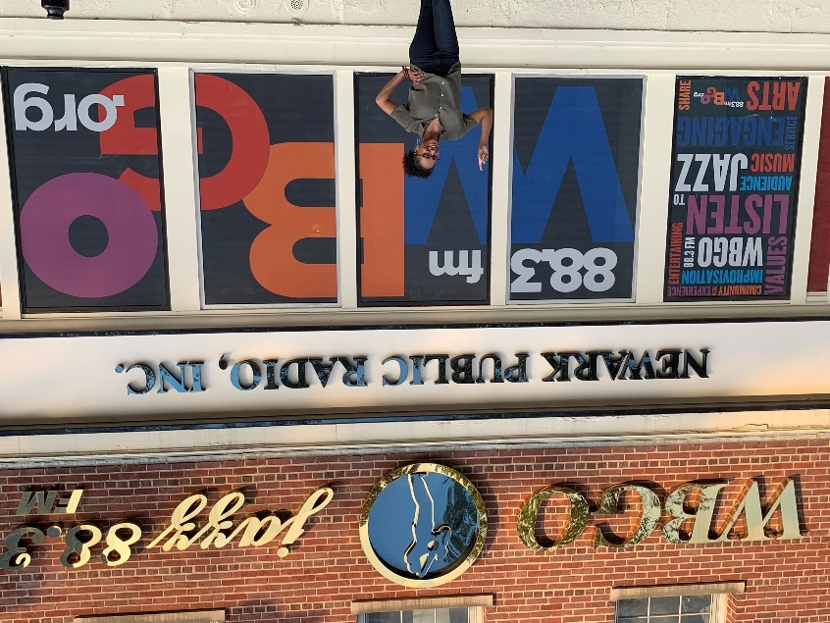
2021-2022 Events
Women’s History Month, March 2021
Reflection and discussion on influential women in our communities. Discuss why women may not experience gender equality as they have defined it. Reflect on the role that we, as men, have in promoting and creating equitable spaces. Guest Speaker: Ms. Keanna Faircloth of WBGO jazzy 88.3FM.

Slide 10
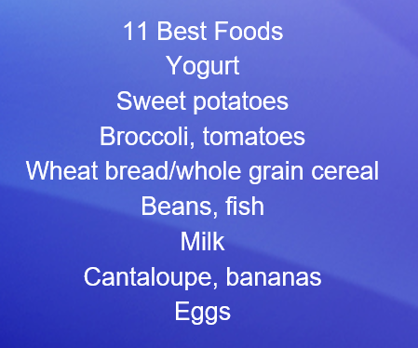
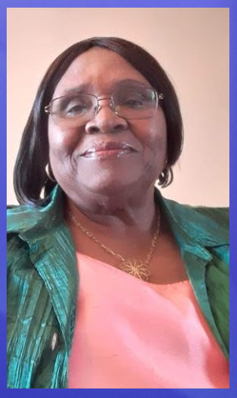
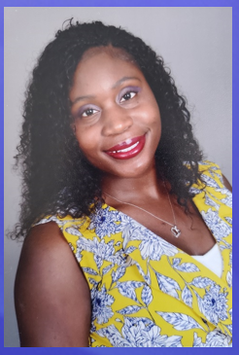
2021-2022 Events
Childhood Obesity, April 2021
Nutrition Workshop: Dieticians provided healthy nutrition practices for both children and young adults. Focused on healthy eating, healthy eating choices Guest Speakers: Rosaline & Nkechi Fyle

Slide 11
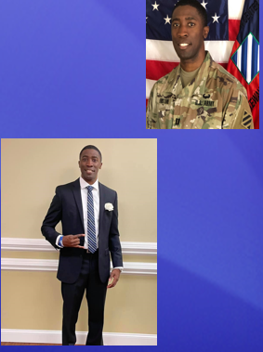
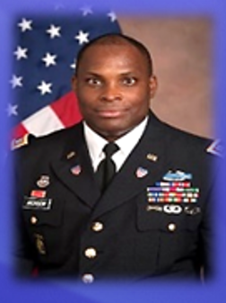
2021-2022 Events
Self-Accountability and Motivation, May 2021
To address the noted uptick in disciplinary issues in our youth due to the pandemic, we focused on self-accountability and motivation. The young men had the opportunity to hear directly from military men how to check in with themselves, hold themselves accountable, check in with themselves and rejuvenate their motivation for success. Guest Speakers: Major Rodney Jackson and Major Calvin Fortune

Slide 12
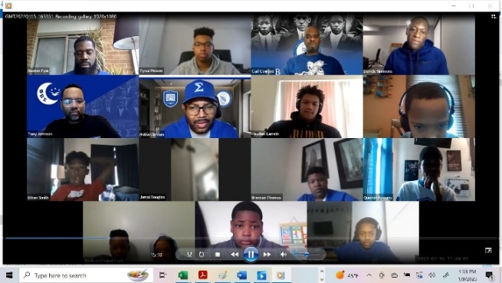
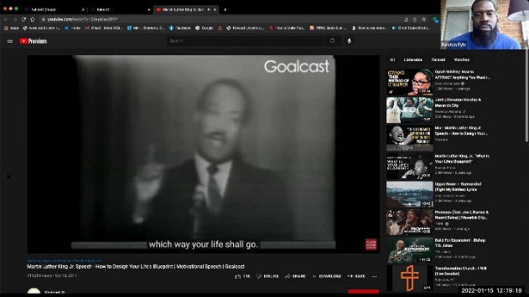
2021-2022 Events
Martin Luther King Jr., January 2022
We moved forward with an initiative we began late in 2021 where Sigma Betas were requested to present content in our virtual sessions rather than continuously receiving content from guest speakers and advisors. The presentation and discussion was on the early life of Martin Luther King Jr. and his impact on the Civil Rights Movement. Presenter: Sigma Beta Tyrus

Slide 13
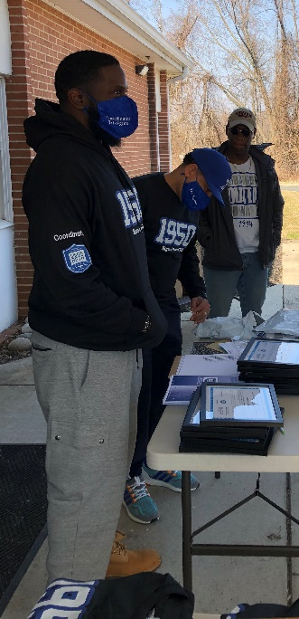
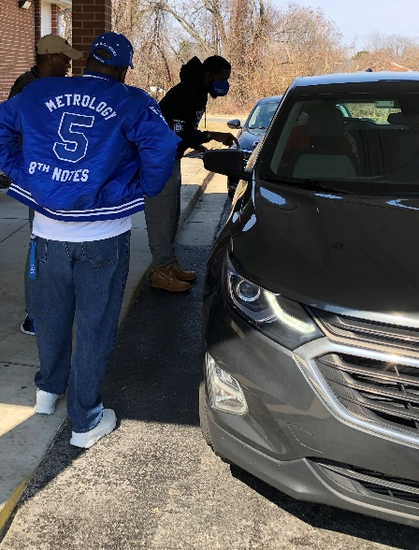
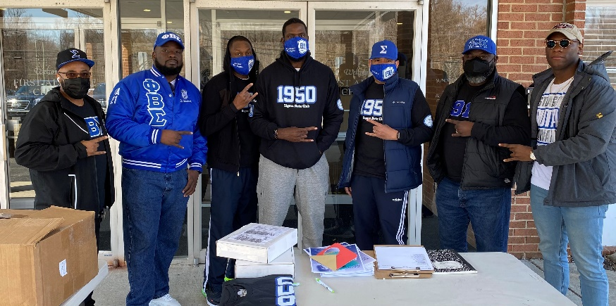
2021-2022 Events
Drive-By Meet, March 2022
We held a brief drive-by session for the Sigma Betas so the advisors and Betas could see each other briefly and so we could distribute Sigma Beta para and a few other items to the young men.

Slide 14
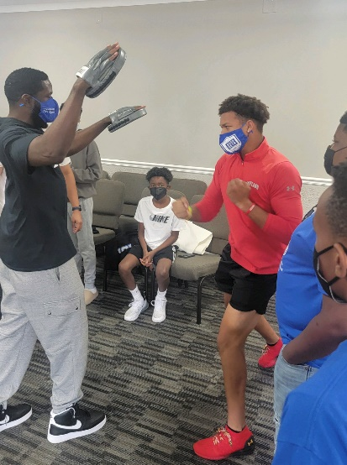
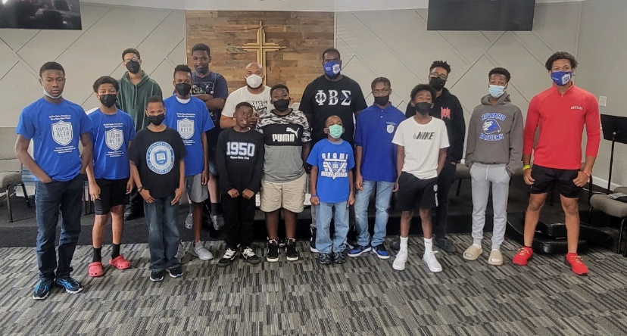
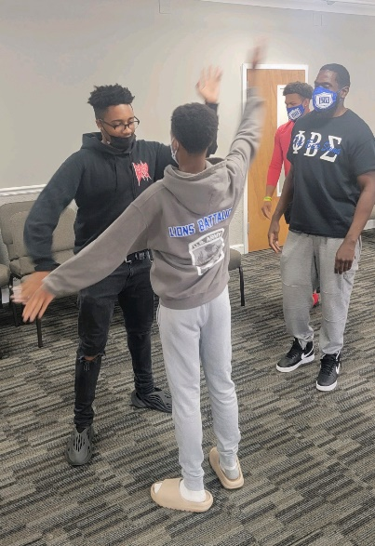
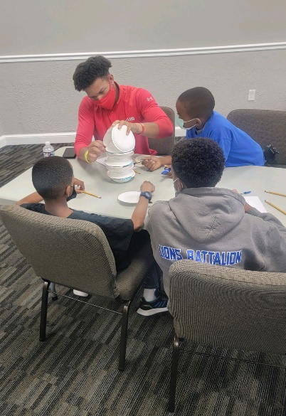
2021-2022 Events
1st In-Person Session, September 2022
1st in-person session since COVID-19. Team building exercise for the Betas to get to know each other. Provided a SMART Goals assignment for the 2022-2023 academic year. Held a discussion on different opinions regarding the Queen of England’s passing, and closed with a self-defense expert’s interactive exercises.

Slide 15
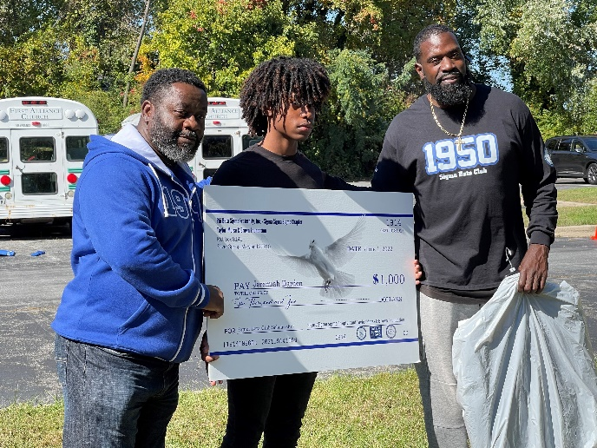
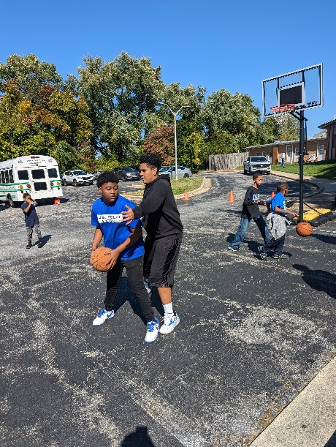
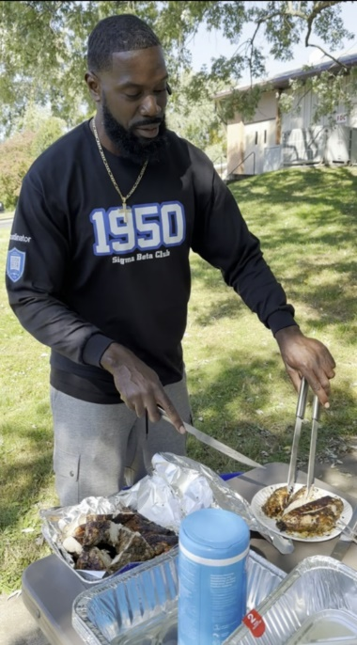
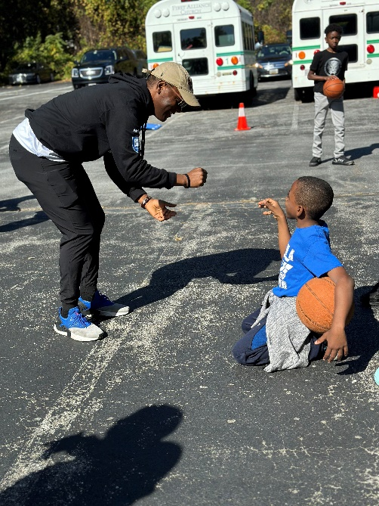
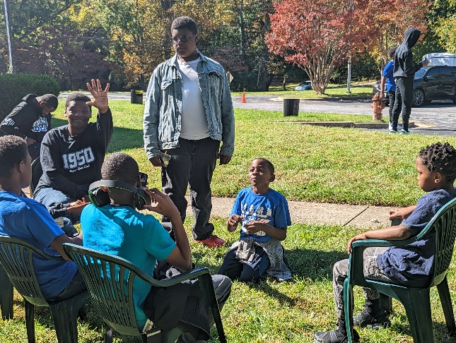
2021-2022 Events
SBC BBQ, October 2022
We invited the Sigma Betas and the 2022 SBC graduates to attend an outdoor BBQ rather than having an indoor session. The Betas played basketball and did other physical activities. TMB Foundation presented the 3rd of our four 2022 graduates with his Scholarship and gifts.

Slide 16
2021-2022 Successes
Maintained a high-quality standard of diverse programming whether meeting virtually or in-person
Completed 12 virtual sessions with an average of 15 Betas in attendance, 3 in-person sessions with an average of 12 Betas in attendance, 1 drive-by session and a scholarships distribution
Operated successfully with the uncertainty of not knowing when we would be allowed meet in person
We successfully met our 2021/2022 goals. The programming content success was measured by program attendance and feedback from Betas, parents and advisors

Slide 17
2023-2024 Direction
Community Service: We’d like to get the Betas active in performing service
Induction Ceremony: We have at least 4 candidates interested in becoming Sigma Betas. We can plan to have a ceremony in Summer or Fall
Awaiting feedback from Betas, Families and the Advising Committee
Looking forward to the club getting back to performing service in the community

Slide 18
COVID-19 Regulations
Risk Management
Transportation: ***Advisors cannot transport any Sigma Betas unless they are their own children***
Waivers: The NSBCF waiver forms must be completed for every session or activity until further guidance in received
Masks: Masks are to be worn indoors at SBC hosted functions

Slide 19
Closing Remarks
I will be out of the country Feb 14 – 23, 2023
Next Session, Saturday Feb. 18, 2023 from 11:30am-1:30pm at First Alliance Church. Ice Breaker, Black History Month Activity, Discussion on Tyre Nichols’ facilitated by law enforcement – Mr. Jerome Ferguson
Please complete your COVID waivers and send them to me electronically in advance
Vote of Thanks!!!

Slide 20
Questions
Questions ?

